Slide 1
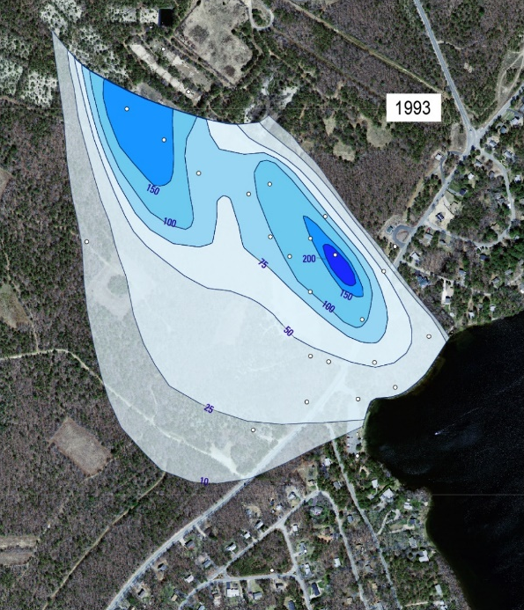
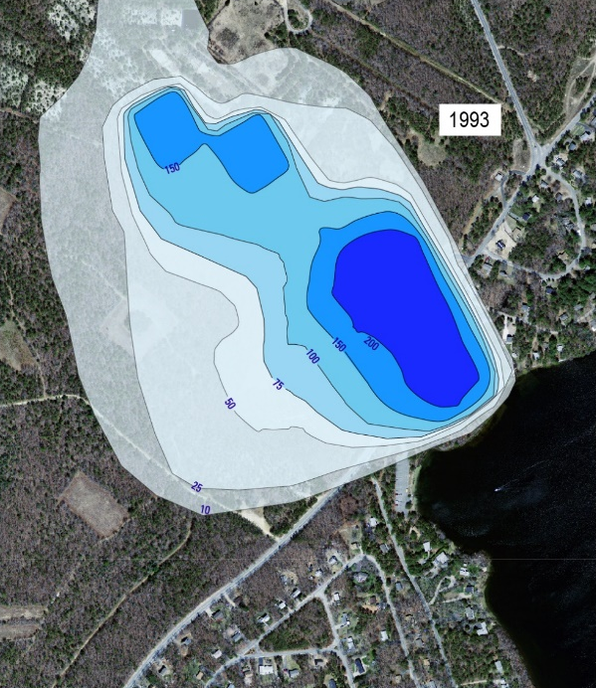
Phosphorus Modeling Redux
David, John Colman, Tim, and others

Slide 2
Themes
What worked?
What could we have done better then?
What could we do better now?

Slide 3
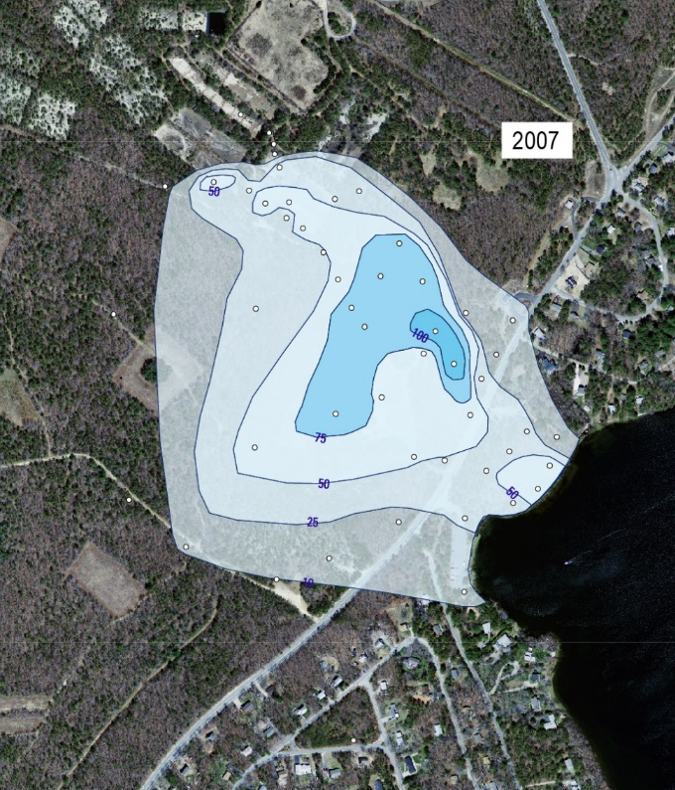
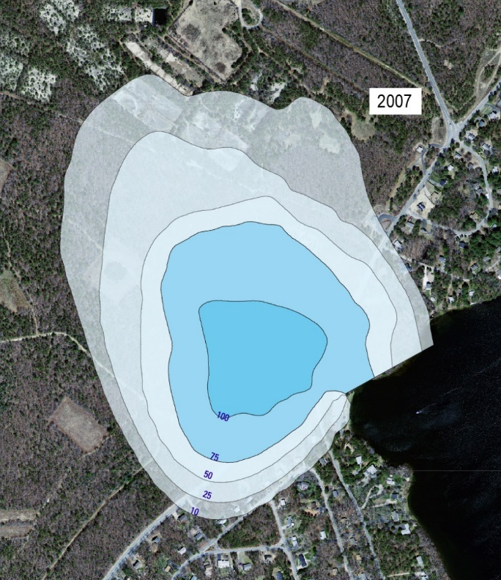
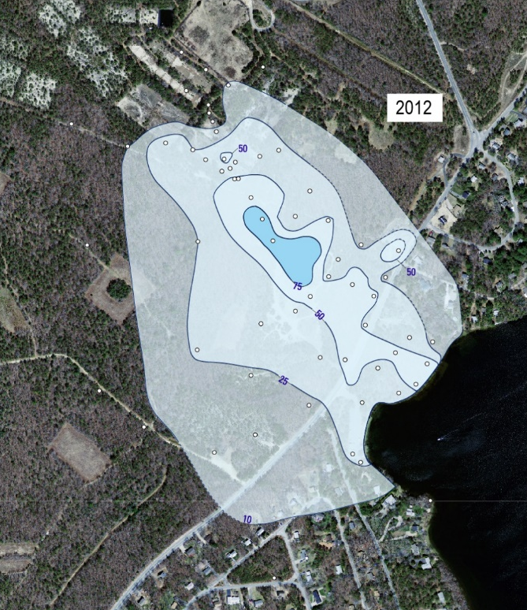
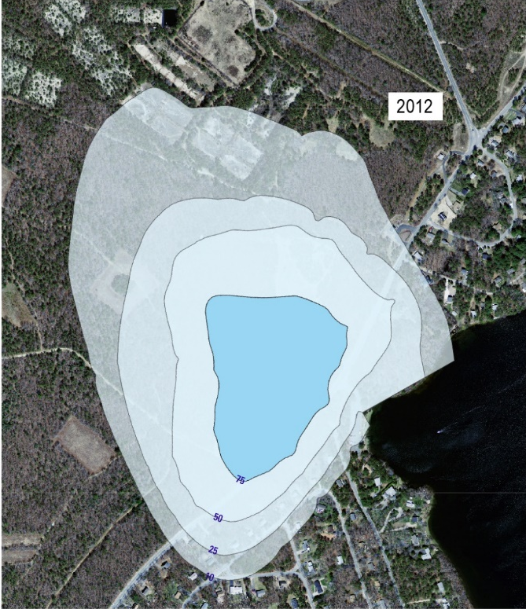
FLOW/TRANSPORT
Is the flow description adequate?
Modeled NH3 plume is always too deep
Latest Cape GW model
Boundary conditions
Can now use a finer grid, previously 30 m dispersivity
Loading of beds

Slide 4
Fluxes to Ashumet Pond
Comparison with Tim’s work
Consideration of reactive barrier?

Slide 5
REACTIONS

Slide 6
SORPTION
Is the trailing edge the most important?

Slide 7
Cation Sorption
Do we need to do better than a single mechanism for all cations?
Do anions and cations compete for the same sites?

Slide 8
Iron and Manganese
Manganese seems to persist longer than modeled

Slide 9
Organic Carbon
Do we want to model the oxygenation?
Does it affect phosphorus?

Slide 10
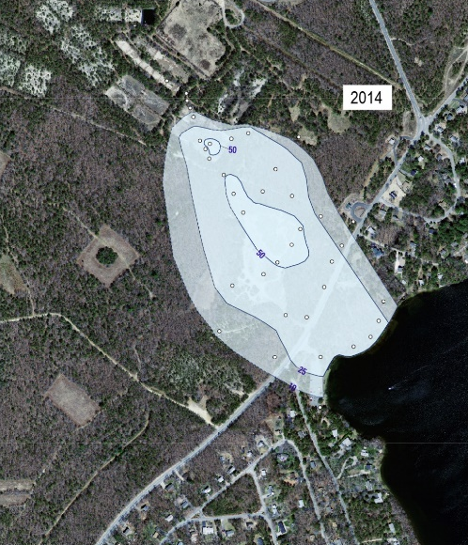

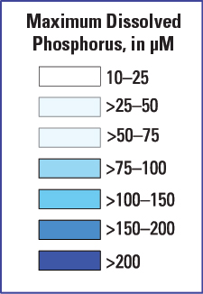
Phosphate Minerals
Phosphorus is less persistent than modeled
Refit the kinetics over the longer time period?
Are there other minerals that should have been considered?
(More Pb-PO4 minerals than I thought)

Slide 11
Denitrification
Does it fit available data?
Does it matter for phosphorus?

Slide 12
Other Chemisty
What did we miss?

Slide 13
PEST
It is feasible to run parameter estimation
What to fit?
3D field
2D interpolation
Mass
Concentration

